Slide 1
Image Processing in Python
Matthew Lowe
Matthew.Lowe2@christie.nhs.uk

Slide 2
In this session we will learn about:
Loading images
Using colourmaps
Zooming/cropping
Shifting images
Applying masks
Flipping images
Rotating images
Blurring images
Overlaying images
Using transparency
Resizing images
Setting different window levels
You will be able to try these out during this session using the workbook.
Feel free to experiment to help you understand what is being done.

Slide 3

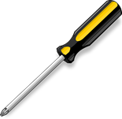
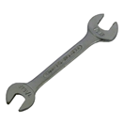
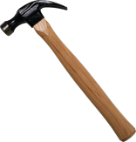
First let’s import some useful libraries
import matplotlib.pyplot as plt import numpy as np
from scipy import misc
plot()
read()
libraryA
mean()
read()
libraryB

Slide 4
Function: imread belongs to the ‘misc’ namespace
image = misc.imread("bird.jpg")
Variable name:
Could be anything. Try to pick something meaningful. Ideally, function names should be lowercase, with words separated by underscores as necessary to improve readability.
Function arguments:
In this case it is the file that we want to open.
Because it is in the same folder we can just write the name of the file. Otherwise we would write the path to the image.

Slide 5
Function: imshow belongs to the ‘plt’ namespace. It displays an image on some axes
plt.imshow(image)
Function arguments:
In this case it is the variable holding the image data.
Lots of other arguments are available. We’ll see some later.
http://matplotlib.org/api/pyplot_api.html#matplotlib.pyplot.imshow
plt.show()
Displays the figure

Slide 6
print image
print image.shape
Array dimensions
An image is just an array of numbers.
What is the shape of the array?
Why does it have this shape?

Slide 7
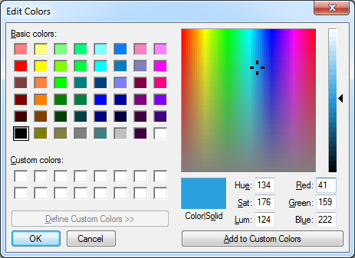

Slide 8
We want to copy the array that is stored in the variable “image”
New variable
blue_image = image.copy()
blue_image[:, :, 0] = 0
blue_image[row, column, channel] = 0
This sets the first channel in every pixel to be zero
Remember:
[1:5] is equivalent to “from 1 to 5” (5 not included)
[1:] is equivalent to “1 to the end”
[:5] is equivalent to “from the start to 5” (5 not included)
So, [:] means from the start to the end

Slide 9
Creates a new figure as a variable called “fig”
fig = plt.figure() ax = fig.add_subplot(221) ax2 = fig.add_subplot(222) ax3 = fig.add_subplot(223) ax4 = fig.add_subplot(224) ax.imshow(image) ax2.imshow(red_image) ax3.imshow(blue_image) ax4.imshow(green_image)
plt.show()
Add some axes
Here, there are 2x2 subplots
1
2
3
4

Slide 10
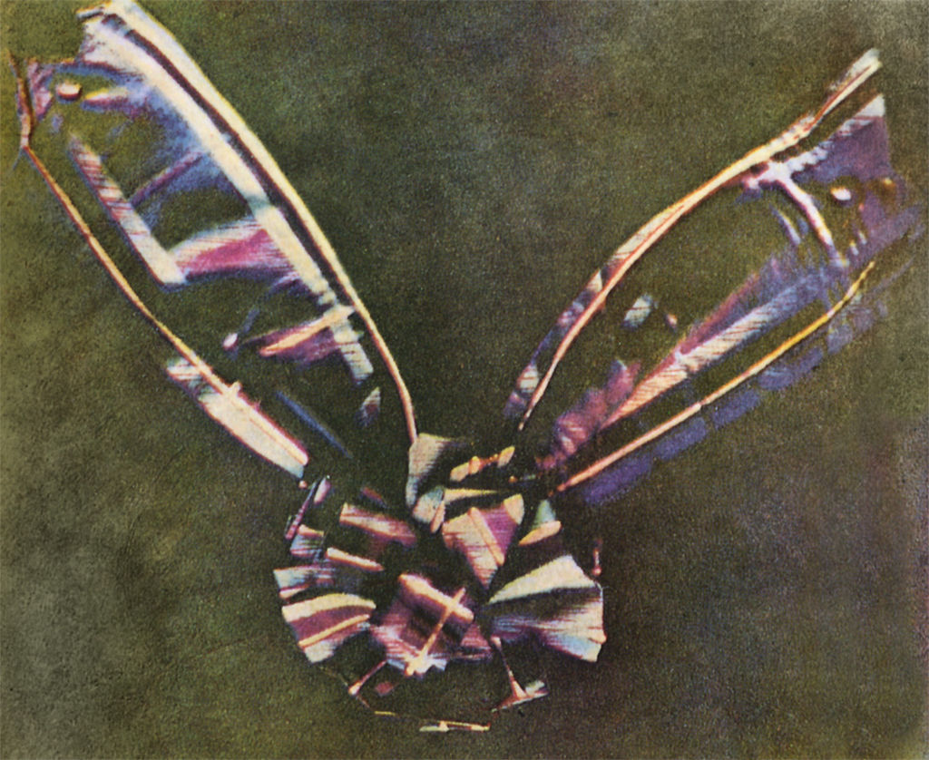

Slide 11
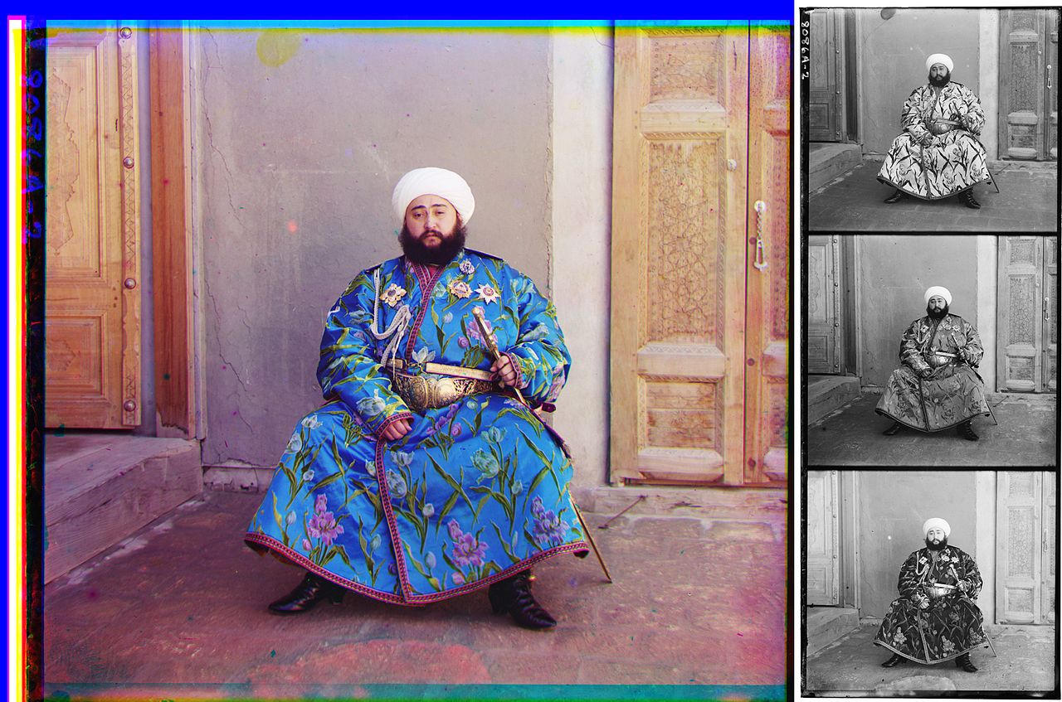
A photograph of Mohammed Alim Khan (1880–1944), Emir of Bukhara, taken in 1911 by Sergei Mikhailovich Prokudin-Gorskii using three exposures with blue, green, and red filters.

Slide 12
We have 3 colour channels (In some cases we might have 4 channels, in this case the last one is transparency)
Let’s simplify things and just have one value for each pixel. This value should contain the mean value over the three channels.
We will use the “mean” function from numpy (Remember we imported it as “np” earlier)
With numpy we can do functions on arrays very efficiently without having to loop through every element
mean_image = np.mean(image, -1)
Function arguments: The first argument here is the array we want to calculate the mean over. The second argument is an axis we are calculating this over. -1 means the last one, we could put a 2 here instead.

Slide 13
a = np.linspace(0,24,25) a.shape=(5,5)
np.mean(a) np.mean(a,0) np.mean(a,1) np.mean(a,-1)
What is the output of:

Slide 14
We’ve now averaged over all three colour channels*.
What happens if we display this array now?
Why does it look like this?
*There’s an easier way to flatten the image though:
image = misc.imread("bird.jpg“, flatten=True)

Slide 15
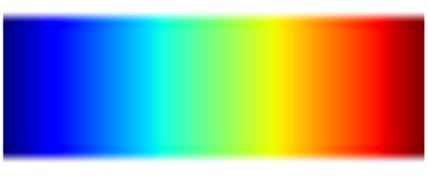
The image is now using the default colourmap.
A colour map translates numbers into different colours. The default colour map (called “jet”) looks like this:
Is this a good colourmap?
Low value
High value

Slide 16
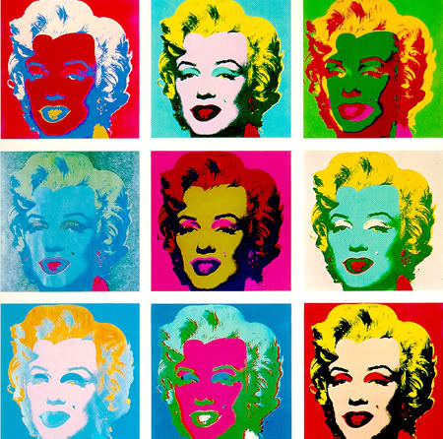
Let’s explore some other colourmaps

Slide 17
Try some of these colour maps:
viridis, inferno, plasma, magma, Blues, BuGn, BuPu, GnBu, Greens, Greys, Oranges, OrRd, PuBu, PuBuGn, PuRd, Purples, RdPu, Reds, YlGn, YlGnBu, YlOrBr, YlOrRd, afmhot, autumn, bone, cool, copper, gist_heat, gray, hot, pink, spring, summer, winter, BrBG, bwr, coolwarm, PiYG, PRGn, PuOr, RdBu, RdGy, RdYlBu, RdYlGn, Spectral, seismic, Accent, Dark2, Paired, Pastel1, Pastel2, Set1, Set2, Set3, gist_earth, terrain, ocean, gist_stern, brg, CMRmap, cubehelix, gnuplot, gnuplot2, gist_ncar, nipy_spectral, jet, rainbow, gist_rainbow, hsv, flag, prism
What happens if you put “_r” after the name
(e.g. “Greys_r”)?

Slide 18
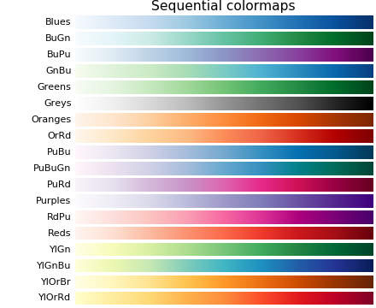
Sequential: These colourmaps are approximately monochromatic colourmaps varying smoothly between two colour tones-usually from low saturation (e.g. white) to high saturation (e.g. a bright blue). Sequential colourmaps are ideal for representing most scientific data since they show a clear progression from low-to-high values.
http://matplotlib.org/users/colormaps.html

Slide 19
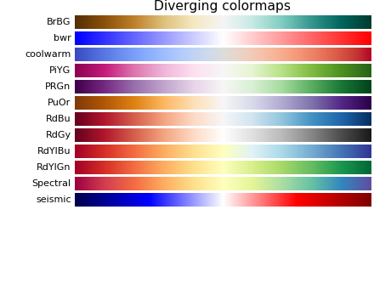
Diverging: These colourmaps have a median value (usually light in colour) and vary smoothly to two different colour tones at high and low values. Diverging colourmaps are ideal when your data has a median value that is significant (e.g. 0, such that positive and negative values are represented by different colours of the colourmap).
http://matplotlib.org/users/colormaps.html

Slide 20
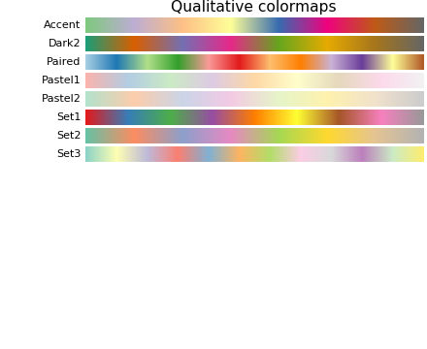
Qualitative: often are miscellaneous colours; should be used to represent information which does not have ordering or relationships.
http://matplotlib.org/users/colormaps.html

Slide 21
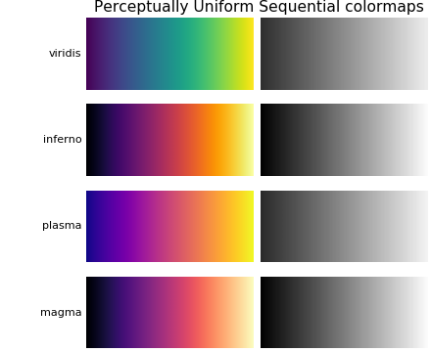
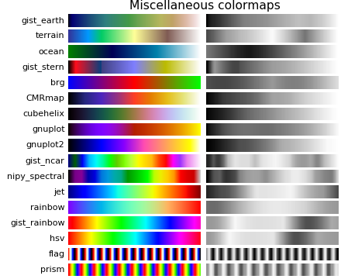
What is intuitive?
What is standard?
How would it look in black and white?
How would it be perceived by readers with colour-blindness? (4.5% of people)

Slide 22
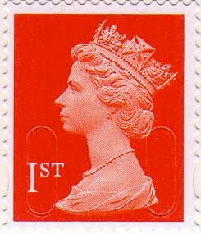
Let’s make a stamp

Slide 23
im = misc.imread("thequeen.jpg")

Slide 24
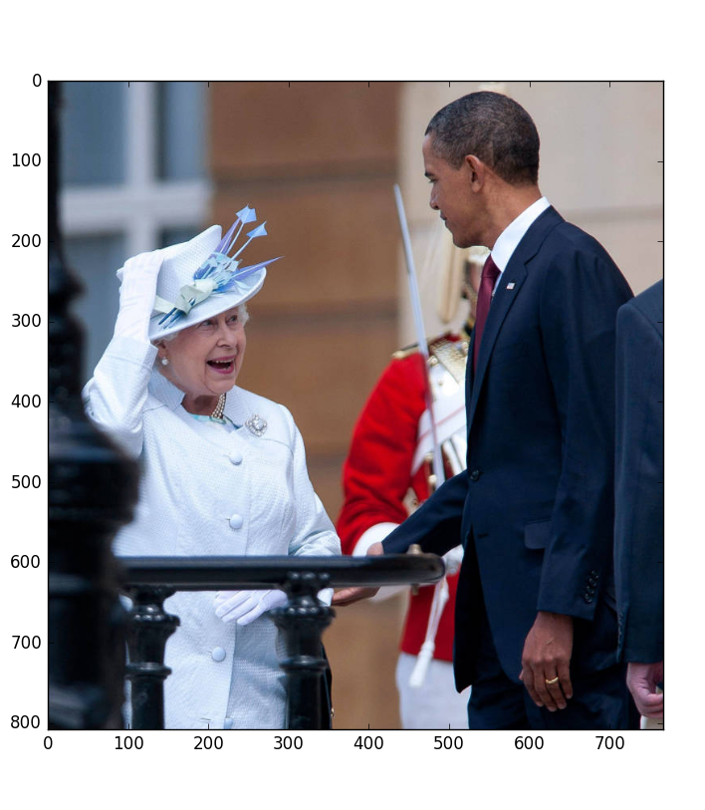

Slide 25
We can slice an array just like we can slice a list, each dimension is separated by a comma
cropped = im[row_{start}:row_{stop}, col_{start}:col_{stop}]

Slide 26
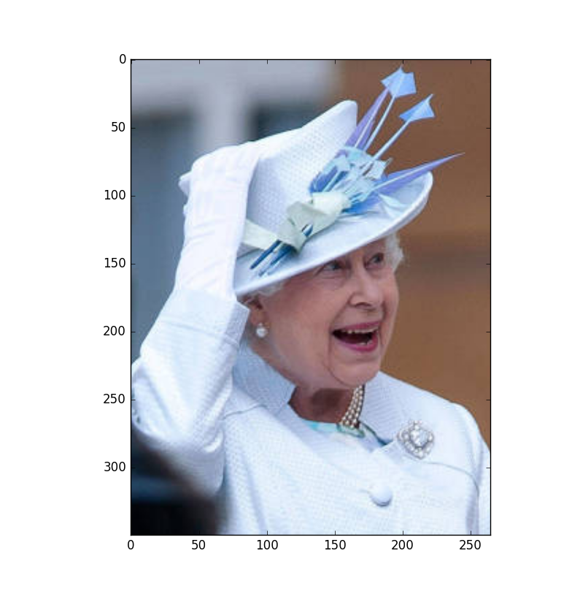

Slide 27
flipped = np.fliplr(cropped)
or
flipped = cropped[:,::-1]

Slide 28
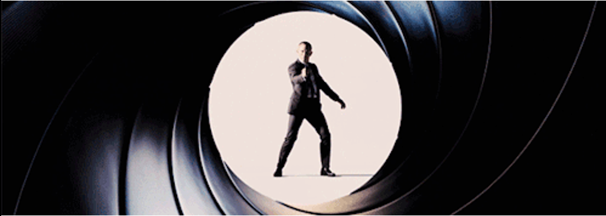

Slide 29
A new variable
The shift along the axes as a tuple
shifted_image =
interpolation.shift(im, (60, -20), mode="nearest")
The array we want to shift
How points outside the array should be filled. Nearest means that they take the value of the nearest point

Slide 30
Remember, this gave us the array dimensions as a tuple.
We are now assigning these dimensions to the variables lx and ly
lx, ly = shifted_image.shape
This gives us a grid with one horizontal array and one vertical array
X, Y = np.ogrid[0:lx, 0:ly]
mask = (X - lx / 2) ** 2 + (Y - ly / 2) ** 2 > lx * ly / 3
The mask is an inequality… It is also an array so it will be made out of Trues and Falses

Slide 31
With this reference, we are only picking out the array elements that are True
shifted_image[mask] = 0

Slide 32
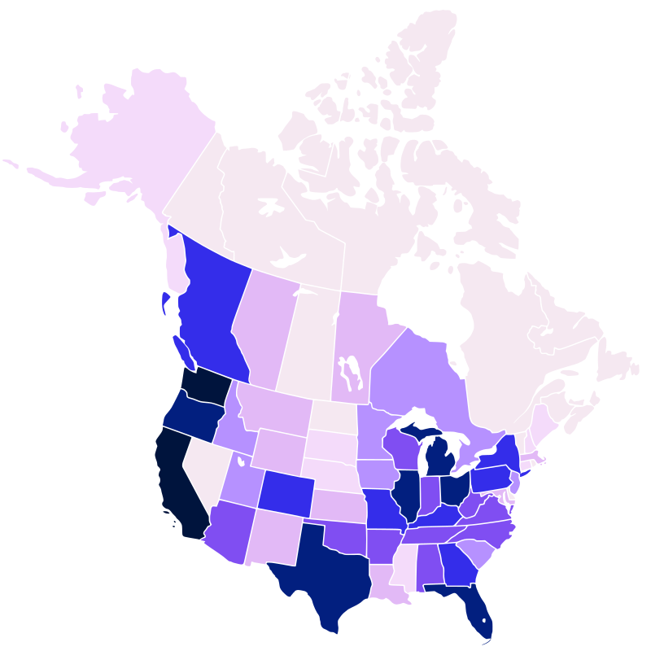

Slide 33
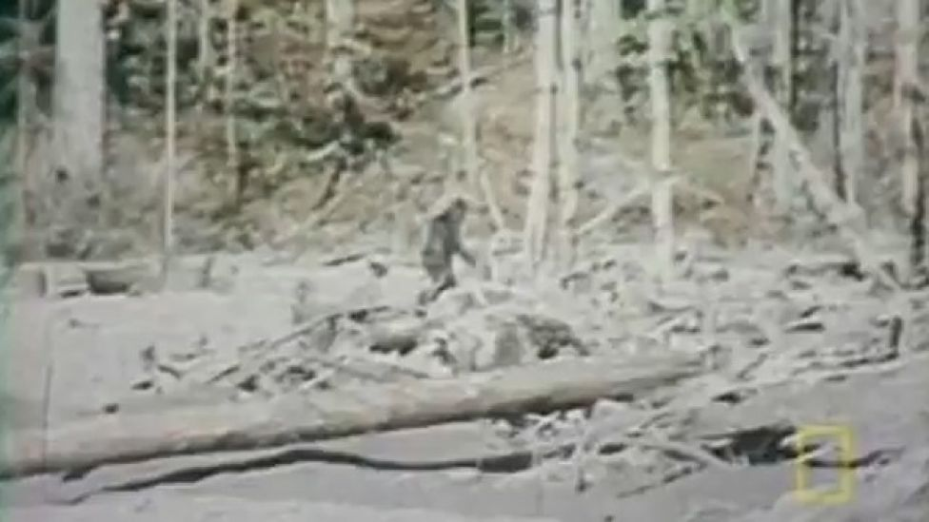

Slide 34
The standard deviation of the gaussian
blur = ndimage.gaussian_filter(im, sigma=20)
The image we want to blur
We could achieve something similar by convolving with a Gaussian similar to how you used convolution yesterday.

Slide 35
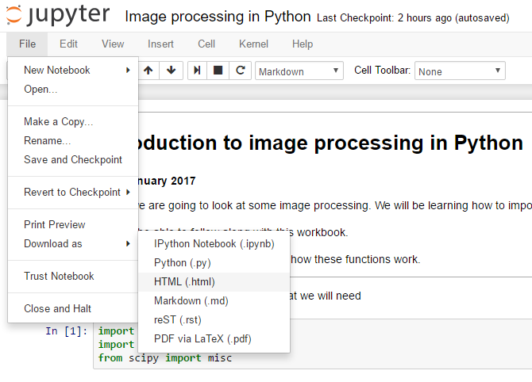
You can save your workbook to a pdf or html so that you have a copy of what you’ve done.

Slide 36
We wouldn’t normally write code in a notebook like we did this morning.
This afternoon, we are going to start writing code in a file which we can run.

